Slide 1

Update on the HDF5 standardization effort
Elena Pourmal, Mike Folk
The HDF Group
July 20, 2006
SPG meeting, Palisades, NY

Slide 2
Outline
HDF5 status
Lessons learned or thoughts about the standardization process

Slide 3
HDF5 Status
Three documents were submitted to SPG in March 2006
  HDF5 Data Model
  HDF5 File Format (release 1.6.5)
  HDF5 Reference Manual (release 1.6.5)
Current response from reviewers (4 total, one is for HDF4)
  Reviews emphasized
    HDF complexity
    Backward-forward compatibility
  No reviews on “accuracy” and “clarity”, mostly address “usefulness” of HDF

Slide 4
Struggles with HDF5 standardization
HDF5 is represented at least by 4 layers
  Abstract Data Model
  APIs
  I/O library
  File Format (XML, binary)
Should these be standardized independently, or are they all of a piece?

Slide 5
Struggles with HDF5 standardization
In our first attempt, we treated them of a piece
  Linked #1 & #4: storage layout treated as part of data model
  To an extent #2 also linked: object methods reflected by APIs
But one layer can evolve without changes in another
  E.g. variable size chunking will need file format change, but it will not change the data model
  E.g. new compression will tweak APIs, but may not change format or data model
Compare to, say, OPeNDAP
  Just one layer involved -- doesn't describe persistent storage

Slide 6
Struggles with HDF5 standardization
Objects “in memory” vs. objects “in a file”
  May lead to different implementation
Terminology usage (e.g. “persistent” object)
  Document is not always clear and accurate
In our first attempt:
  We didn’t describe objects in memory
  Removed “persistent” to make document “clear” and introduces inaccuracy: only objects stored in a file (persistent objects) may have attributes

Slide 7
Thoughts about the standardization process
It’s hard!!
  Takes a lot of work to write or review the documents
Can we spread out the work?
  Assign different parts of the doc to different people
  Different people may address different issues
  Different criteria for different reviewers
    accuracy vs. usefulness
  But someone still needs to review the whole thing
  And include a technical writer with special knowledge

Slide 8
Thoughts about the standardization process
Iterative approach definitely the way to go
Both standard and review templates were very useful in our work
Recommend common documentation formats
  Usage of UML, for example

Slide 9
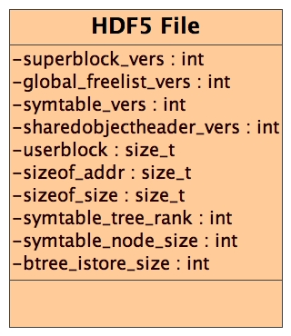
Example: File Class Diagram
“memory” representation
Concise view
Easy to find errors
Easy to review

Slide 10
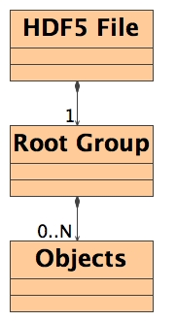
Example: HDF5 File, Root Group, and Objects class diagram
Shows associations
Easy to understand the model

Slide 11
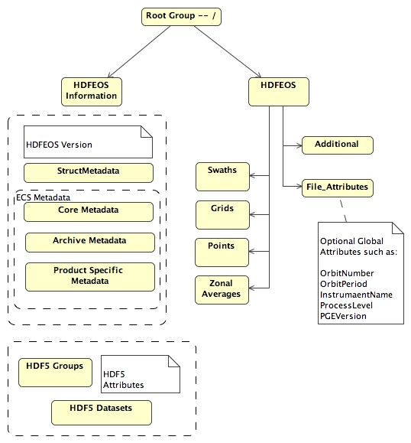
HDF-EOS before … association between objects is missing

Slide 12
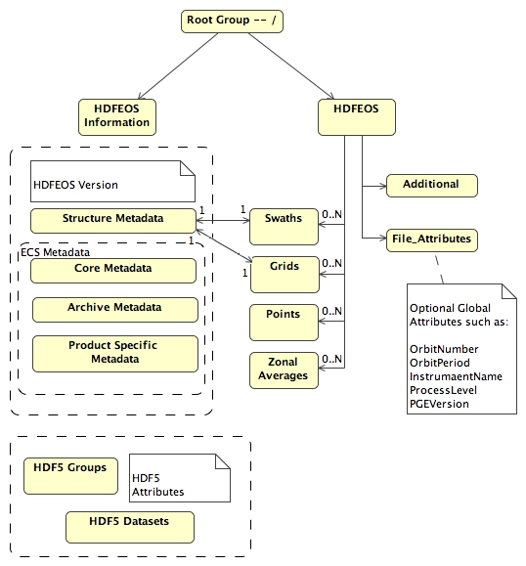
HDF-EOS and after with association shown
Slide has an error.
Can you find it ☺?

Slide 13
IETF a good model in many ways, but…
Consider who participates in IETF
  Mainly lots of developers
  Technologies tend to be near and dear to their hearts
  People excited to participate, volunteer
  Don’t mind spending lots of time on the topics
  Often funded by employer to participate
  And how many IETF standards die on the vine?

Slide 14
IETF a good model, but…
Vs. who participates in ES-DSWG
  Earth Scientists?
    The purpose of the HDF-EOS was to shield them from worrying what is going on under the hood
    Now we ask them review details they would prefer not to know
    So have them assess usefulness, but not accuracy
  IT folks and others
    Definitely appropriate, but don’t expect the passion IETF generates

Slide 15
IETF vs. Earth Science standards
IETF standards often much less complex than ES standards
Some ISO standards perhaps a better model for ES standards
    E.g. EXPRESS/STEP more like HDF-EOS 5 than like TCP. Complex, multi-faceted, domain-related
    Standardization more resource-intensive than IETF
    Participation often supported by employer, can be full-time

Slide 16
Different standards for different goals
Why do standardization? What are our goals?
  Sharing: To share data and tools
  Access: To make data more readily available
  Integrity: To use data in an appropriate or predefined way
  Preservation: To be able to understand and use data in future
  Others?
Each goal achieved by different layers of our standards
  OPeNDAP – sharing and access
  HDF-EOS5 model and API – sharing, integrity, preservation
  HDF5 data model – sharing
  HDF5 File Format -- preservation
Some goals may be achieved just by one layer
  E.g. MATLAB needs just HDF-EOS5 API to access EOS data

Slide 17
One other observation
How about leveraging HDF5 standardization effort with other usage of HDF5 within NASA
  CGNS
  NetCDF4
  Others?

